Slide 1

The Art of Loop Engineering
A comprehensive framework for stacking agentic loops to build reliable, continuous, and self-improving AI systems.
Loop 1: Agent
Loop 2: Verification
Loop 3: Event-Driven
Loop 4: Hill Climbing

Slide 2





Loop 1: The Core Agent Loop
The Basic Agentic Cycle
LangChain Primitives
The most fundamental loop in AI automation. The LLM receives context, plans actions, and dynamically calls available tools in a loop until the goal is met.
Instantiated directly via LangChain's framework with standard model bindings.
Tool Harness: Connects models to structured I/O functions.
Dynamic Reasoning: Decides tool calls based on intermediate step outputs.
Execution Control: Manages chat history and state progression.
Real-World Actions: Reads files, executes code, queries APIs, and pushes changes.
Task Completion: Halts automatically when model emits final answer.

Slide 3


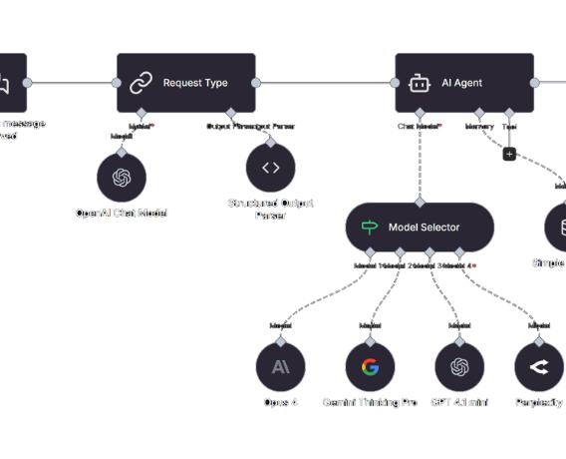
Loop 1: Execution Architecture
Motivating Case: The Docs Agent
Consider an automated documentation assistant designed to process updates, fix broken references, and open pull requests autonomously.
Receive Request: Agent parses issue text or user command.
Tool Calls: Clones Git repository, searches codebase, edits Markdown files.
Action Dispatch: Commits changes and opens a GitHub Pull Request.

Slide 4



Loop 2: The Verification Loop
Wrapping the Agent in Evaluation
Deterministic vs. Agentic Grading
The base agent loop creates initial output, but consistency requires verification. Loop 2 adds a grader to evaluate outputs against strict rubrics.
Graders operate using binary code tests or specialized LLM-as-a-judge evaluation models.
Deterministic: Unit tests, link checkers, schema validators, CI builds.
Feedback Mechanism: Rejects invalid output and requests retry with feedback.
Agentic (LLM Judge): Style compliance, tone checking, semantic alignment.
Error Catching: Eliminates hallucinated facts, syntax breaks, or missed constraints.

Slide 5
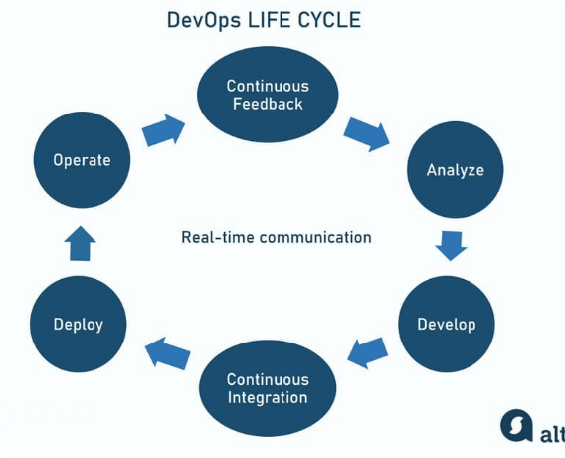
Loop 2: Primitives & Tradeoffs
Implementation & Economics
LangChain provides built-in hooks like and hooks to cleanly wrap agent execution.
Quality vs. Speed: Verification increases latency and token costs per run.
Automated CI: Runs link validation and syntax checks before human review.
Production Standard: Critical when accuracy matters more than raw speed.

Slide 6






Loop 3: The Event-Driven Loop
Webhook Triggers
Cron & Heartbeats
Always-On Ecosystem
Instantly triggers the agent loop when external state changes occur—such as new documents landing, webhooks arriving, or Slack messages posted.
Scheduled cron execution turns agents into proactive assistants that periodically check systems, clean repos, or generate reports without prompt invocation.
Transforms agents from manual single-turn utilities into continuous background workers embedded directly inside production pipelines.

Slide 7

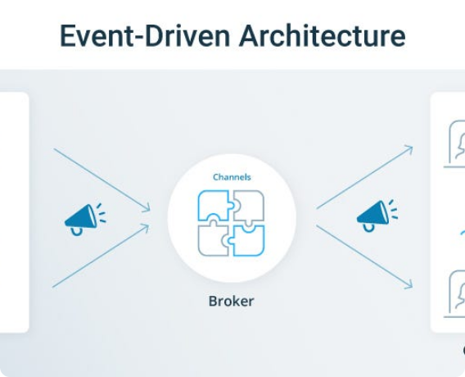
Loop 3: Production Infrastructure
LangChain Event Architecture
LangSmith Deployments and Fleet provide continuous trigger infrastructure for event-driven loops.
Slack Integration: Docs agent listens on channels like and triggers automatically.
OpenClaw Heartbeats: Enables background task polling and proactive maintenance.
Zero Manual Invocation: Continuous execution inside enterprise ecosystems.

Slide 8



Loop 4: The Hill Climbing Loop
Automating Agent Optimization
Outer Loop Meta-Optimization
While Loops 1-3 automate tasks, Loop 4 automates improvement itself. Production execution traces feed an analysis agent to refine system prompts and tool sets.
The return arrow doesn't just loop back to task start—it reaches inside and modifies the inner agent loop configuration directly.
Prompt Tuning: Fixes repetitive errors across hundreds of trace samples.
Trace Signals: Analyzes tool failures, grader rejections, and user edits.
RL Training Signal: Feeds high-value trace outcomes into model fine-tuning.
Harness Modification: Dynamically updates prompts, tool signatures, and rubric rules.

Slide 9

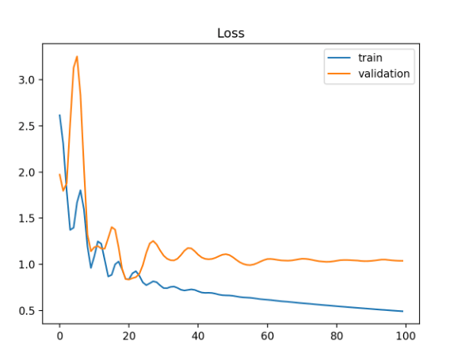
Loop 4: Autonomous Harness Optimization
LangSmith Engine & Learning Loops
LangSmith Engine acts as the analysis agent for Loop 4, turning execution telemetry into permanent system upgrades.
Pattern Detection: Aggregates recurring failures across multiple execution traces.
Auto-Filing Issues: Requests prompt/tool alterations automatically when bottlenecks appear.
Compounding Advantage: Human expertise & token capital compound with every cycle.

Slide 10
Loop Stack & Human Oversight
01
Agent Loop
Model calls tools repeatedly until done.
Objective
Automate discrete work
Component
create_agent
02
Verification
Output scored against rubric; retried with feedback.
Objective
Ensure output quality
Component
RubricMiddleware
03
Event-Driven
External triggers and crons launch agent tasks.
Objective
Automated work at scale
Component
LangSmith Deploy
04
Hill Climbing
Traces feed analysis agent to update harness.
Objective
Continuous improvement
Component
LangSmith Engine

Slide 11




Image Sources
https://n8niostorageaccount.blob.core.windows.net/n8nio-strapi-blobs-prod/assets/workflow_7004_f663b78a76.png
Source: n8n.io
https://www.altexsoft.com/static/blog-post/2023/12/204fe209-5e8b-4d0a-83e8-a30741441944.jpg
Source: www.altexsoft.com
https://miro.medium.com/0*k9vCsZDxVn27YWV0.jpg
Source: medium.com
https://machinelearningmastery.com/wp-content/uploads/2018/12/Example-of-Train-and-Validation-Learning-Curves-Showing-a-Training-Dataset-the-May-be-too-Small-Relative-to-the-Validation-Dataset.png
Source: machinelearningmastery.com

